Slide 1
DEEP LEARNING BASED ON FOOD IMAGE RECOGNITION AND PORTION SIZE DETERMINATION
TEAM MEMBERS
Shreyaa Sridhar ( 21 )
Khushbu Kolhe ( 9 )
Naga Venkata Satya Pranoop Mutha ( 15 )
Geovanni West ( 23 )

Slide 2
Objective
To implement the Food Image Recognition and Portion Size Determination
system that recognizes the image and determines the calories and portion size.
The model will be trained on thousands of images to extract the important
features of these images.
Food-101 Dataset.
Reference link - https://www.vision.ee.ethz.ch/datasets_extra/food-101/
DataSet

Slide 3
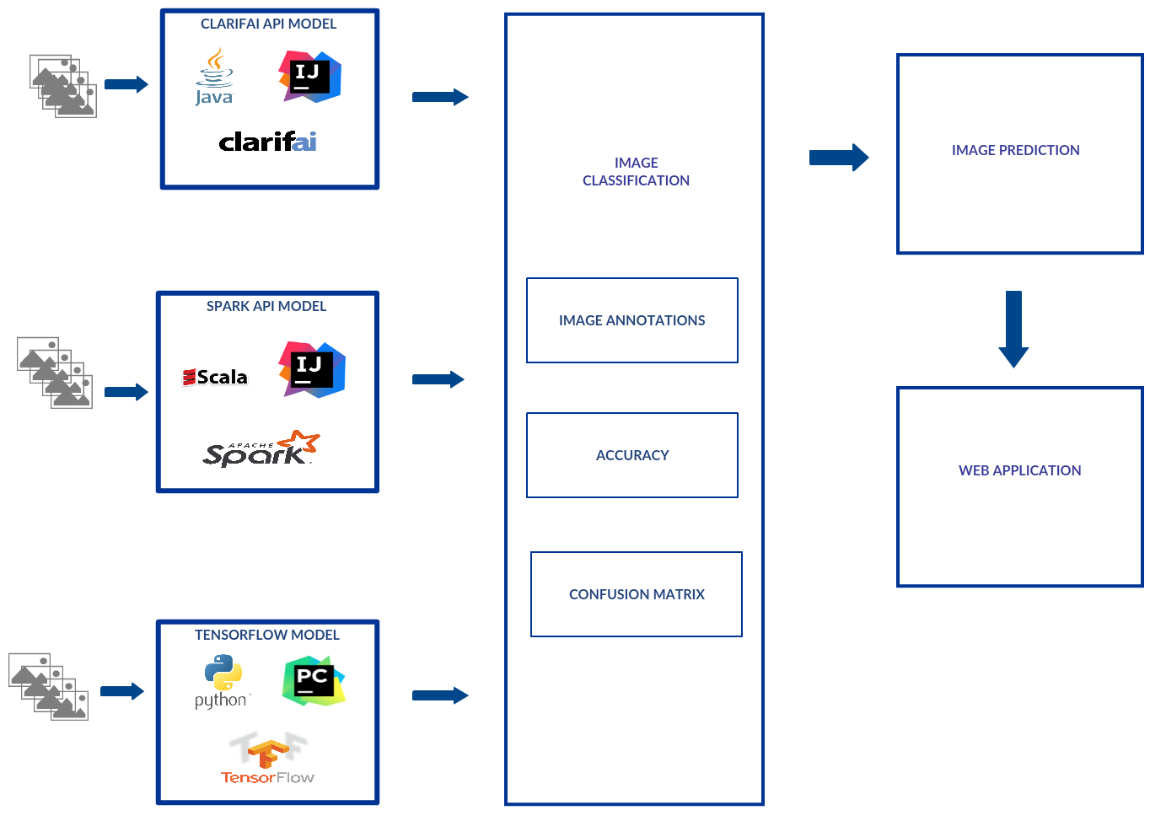
Architecture Diagram

Slide 4
Increment 2
Improved our model accuracy.
Image Classification using deep learning models like SoftMax Regression and Convolutional Neural Network.
Calorie count for food image during prediction using Nutritionix API.

Slide 5
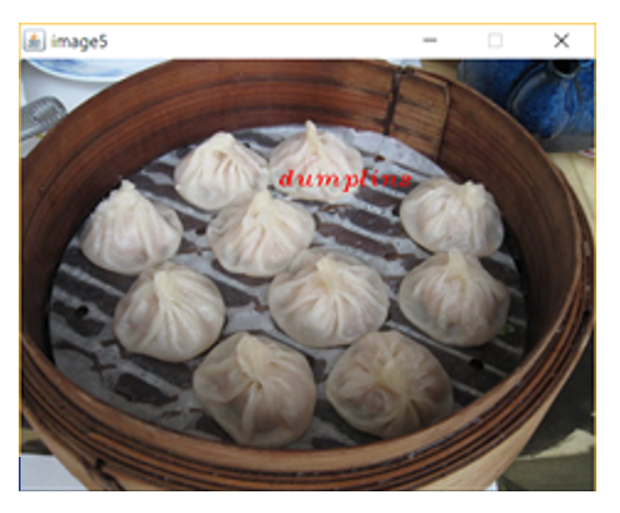
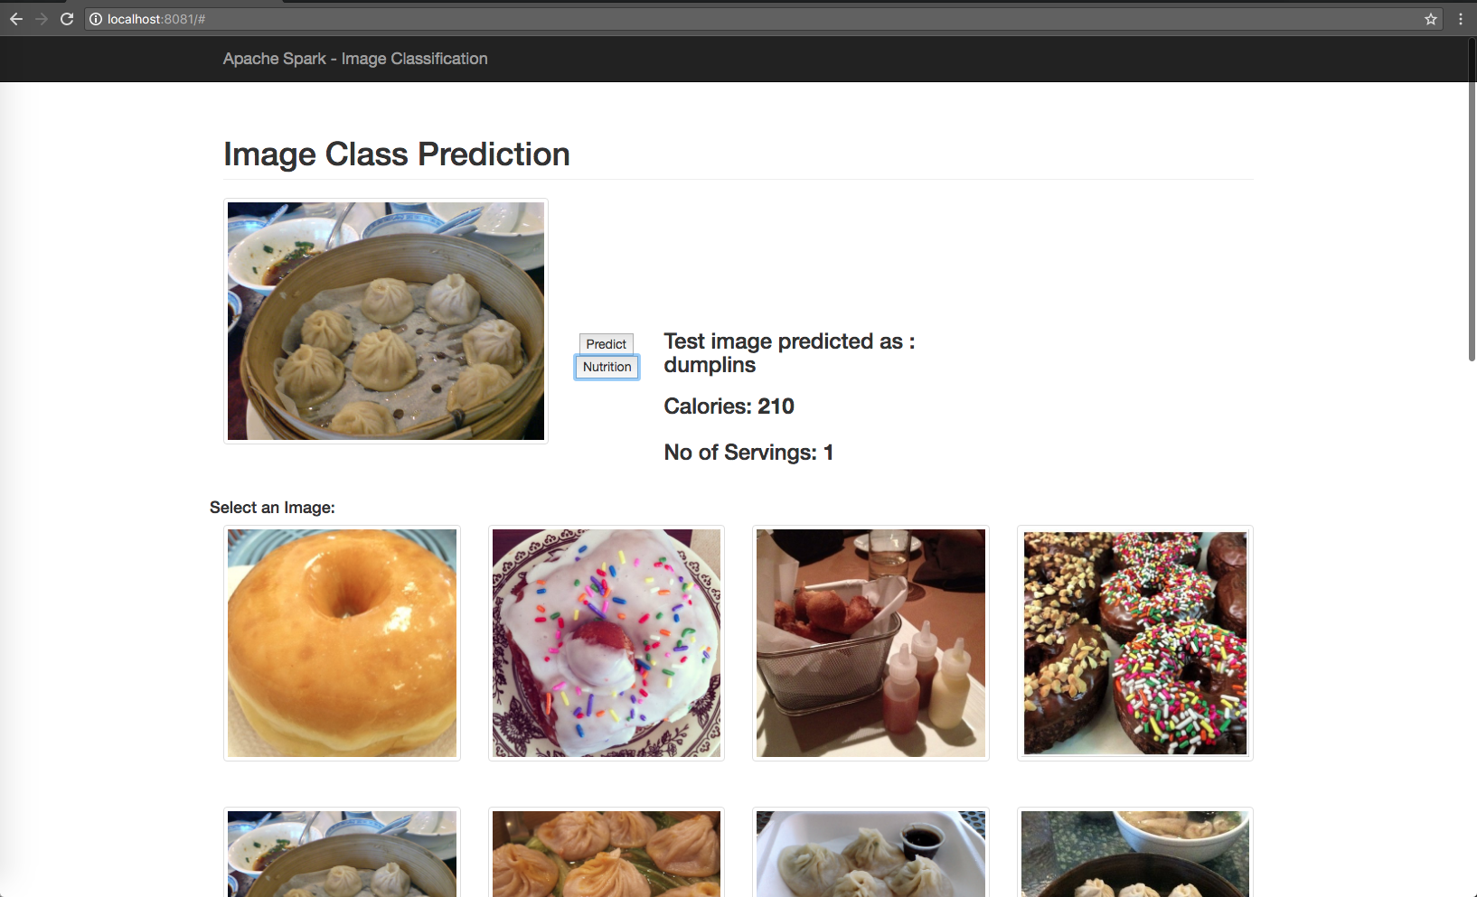
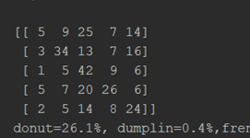
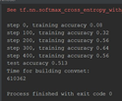
Outputs Generated..
DEEP LEARNING MODELS
SOFTMAX REGRESSION MODEL
Accuracy = 41.85%
CLARIFAI API MODEL
SPARK API MODEL
CNN MODEL(Adam Optimizer)
Accuracy = 51.3%

Slide 6
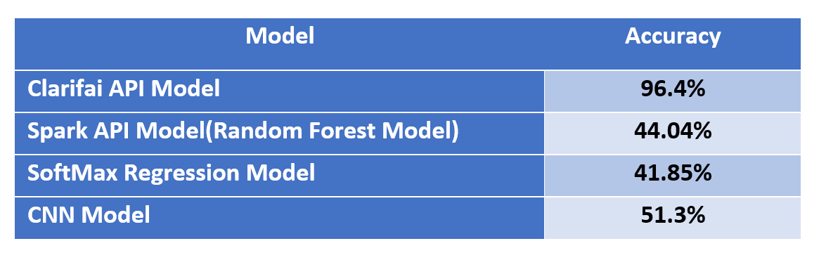
Accuracy of our model
When compared to increment 1,
For Clarifai API model, Accuracy has increased from 92.4% to 96.4%
For Spark API model, Accuracy has increased from 15% to 44.04%

Slide 7
Challenges faced..
We had to use small dataset due to lack of proper hardware resource.
Faced accuracy issue because we trained our model with a small dataset.

Slide 8
Next Increment..
Data Enhancement to improve accuracy of our model.
Use similar image categories
Image Classification using Inception model
Portion SIze Determination
Develop a mobile application

Slide 9
THANK YOU

